Slide 1
Evaluation in HCI (Pre-Design)
Amir Dirin (2018)

Slide 2
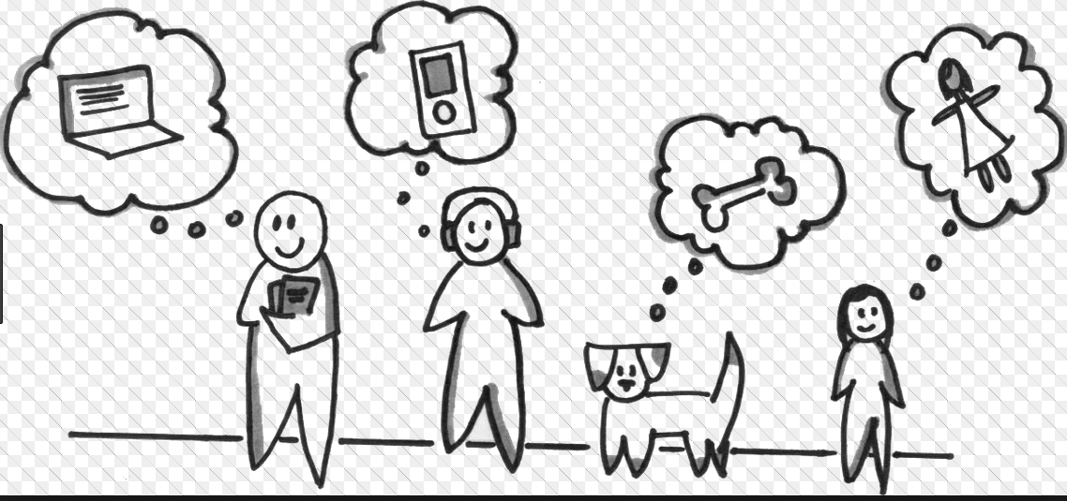
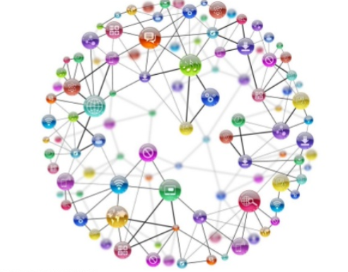

Why do we evaluate in HCI
A. Pre-design stage:
what do people do?
what is their real world context and constraints?
how do they think about their task?
how can we understand what we need in system functionality?
can we validate our requirements analysis?
Who are our user What is their current experience How can we improve

Slide 3
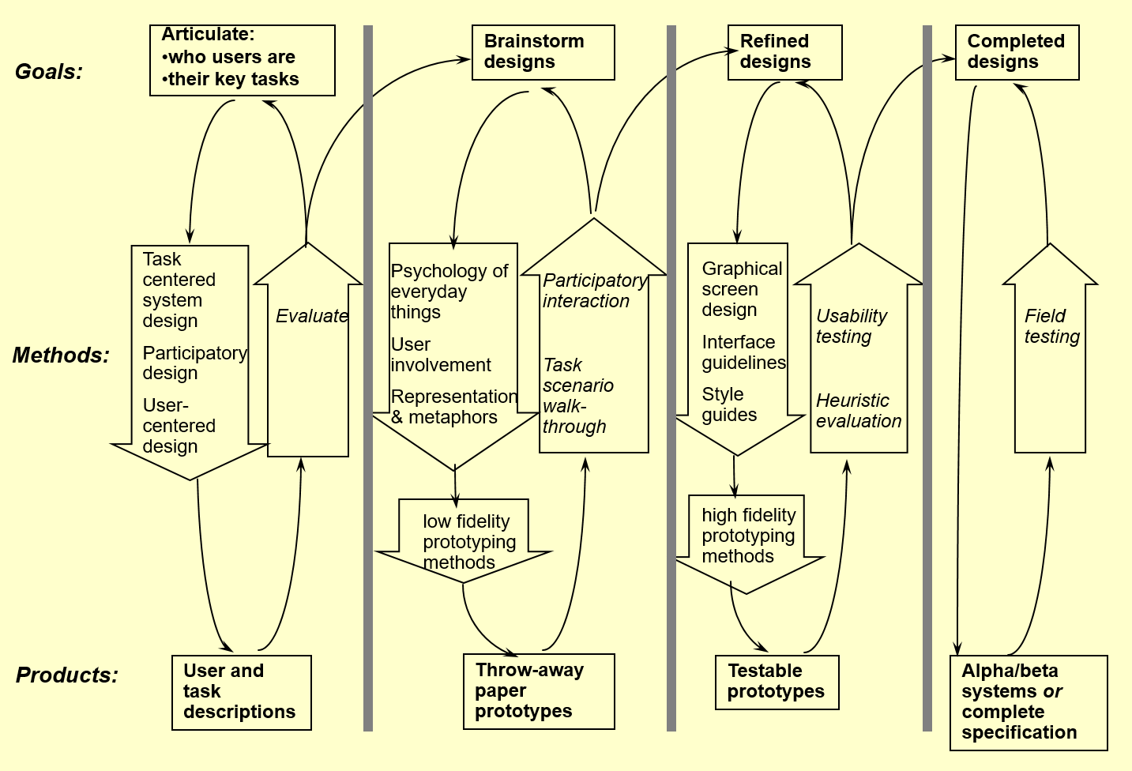
Interface design and Usability Engineering

Slide 4
Why do we evaluate in HCI
Best if apply multiple methods
Methods must fit the design and development constraints
Budget resources, time, product cost
Why use different Methods?
Cost, benefits of using the method
Constraints and pragmatics. May force you to chose quick methods
Quickness, can I do a good job with this method within my time constraints?
Expertise?
Settings
Field vs laboratory

Slide 5
User Profile

Slide 6
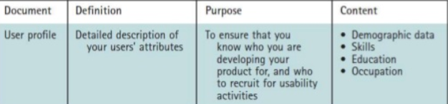
User Profile
A detailed description of your users’ attribute
Job title, experience, level of education, key tasks, age range, etc.
A user profile will help you understand who you are building your product for, and will help you when recruiting for future study…
The first step in understanding your user is to create a user profile

Slide 7
User Profile
Look close at the people engaged in using your tool.
What do your users know about using smart devices and computers?
What do they know about the domain that you are going to design?
Having a good list of users helps us understand functional scope.
How many different types of users will use this software?
What goals the pursue to achieve?
What tasks will they need to perform?

Slide 8
How to create a User Profile
Steps:
Finding information to build your user profile
Understanding the types of users
Creating the user profile

